Slide 1
Crowding Out and Fiscal Policy
HS202

Slide 2
What is Crowding out
The term crowding out refers to the reduction in private expenditure (or invest) caused by an increase in government expenditure through deficit budget via a tax cut or increased money supply or bond issue.
There are three different ways that a national government can fund its spending, and the way it chooses affects the macroeconomic effects of that spending.

Slide 3
Cont.
Pretty much everyone agrees that if a government funds additional spending with taxes, the macroeconomic effects are small.
The tax increase cancels out any multiplier effect of the spending, so its overall effect is negligible.
Also, everyone pretty much agrees that if a government funds additional spending by printing money, the effect on total spending will be large.
No one's spending is cancelled out in this case, and both monetary and fiscal policy are working together.

Slide 4
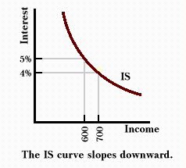
IS curve
(I) for investment (S) for savings When the central bank allows the banking system to create more money, banks increase their lending.
This additional supply of funds reduces interest rates.
Lower interest rates increase investment, which has a multiplier effect on total spending.
A contraction of money will have opposite results.

Slide 5
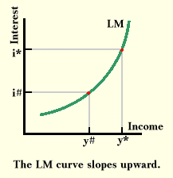
LM Curve
(L for liquidity preference (M) for money supply). If, for example, the government reduces taxes, thereby raising its deficit, it must borrow more.
This added borrowing increases the demand for loanable funds and the price of these funds, which is the interest rate, should rise.
The higher interest rate makes holding idle funds more expensive, and should result in an increased velocity of money.

Slide 6
Effective Fiscal policy
For fiscal policy to be effective as a tool of macroeconomic policy, it must not crowded out other spending.

